Slide 1
CHKS Slide Deck for Students
Survey proctors may use this slide deck to distribute links to students and guide them through the survey process.

Slide 2
Guidance for Proctors
Please remove all slides that do not apply to your grade and/or survey configuration. See Presentation Notes for additional support.
Your CHKS link is on the next slide.

Slide 3
[Paste CHKS link here]
Notes:
Paste your school’s CHKS Link here.

Slide 4
Information to Share with Students
The purpose of this survey is to obtain information from you about your knowledge, attitudes, and behavior about things that affect learning.
You will first answer a question about your current learning situation (distance learning or on campus).
You will then be directed to questions appropriate for your situation.
Your participation is voluntary. It is also very important. The information provided will help guide district and school efforts to promote safety, enhance learning supports, improve student achievement, and reduce health risks that stand as barriers to learning.
This is an anonymous survey. It is designed so that no one can be identified from the data.
All questions apply to this school only.
You may skip any questions you do not want to answer.

Slide 5
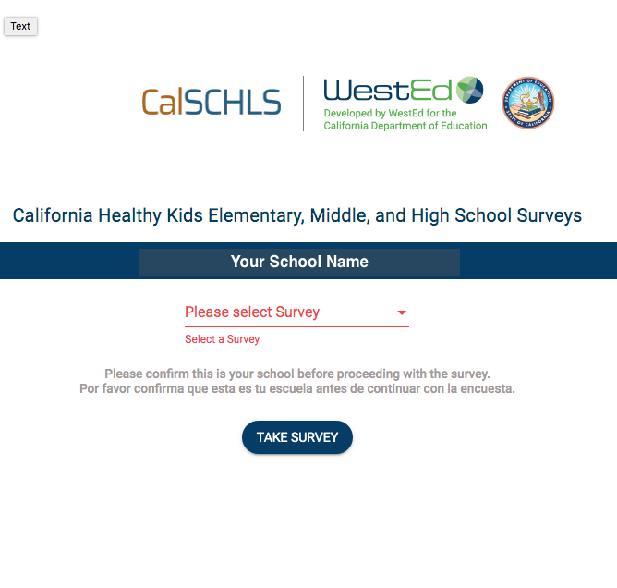
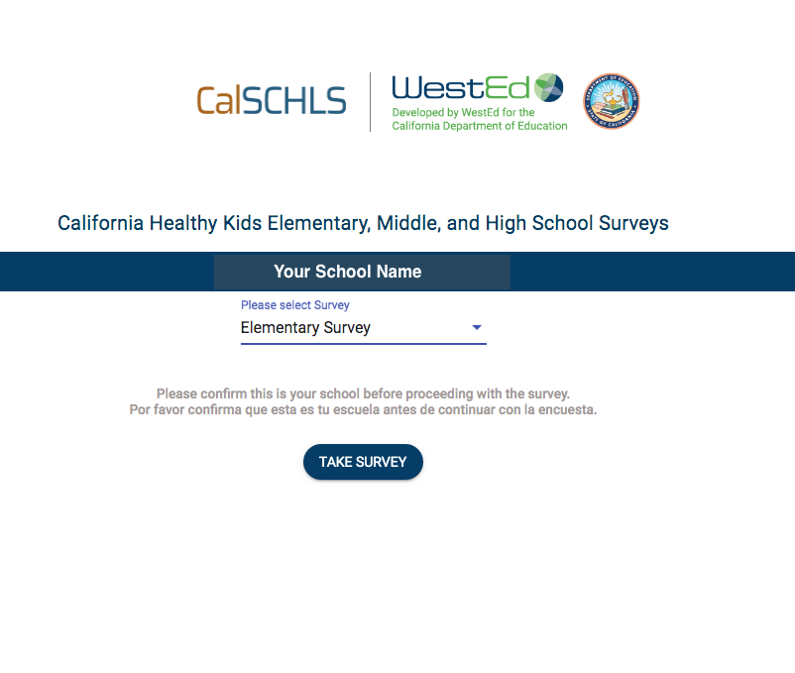
Grades K–5
Notes:
DELETE THIS SLIDE IF YOUR SCHOOL IS NOT A K-5 SCHOOL.

Slide 6
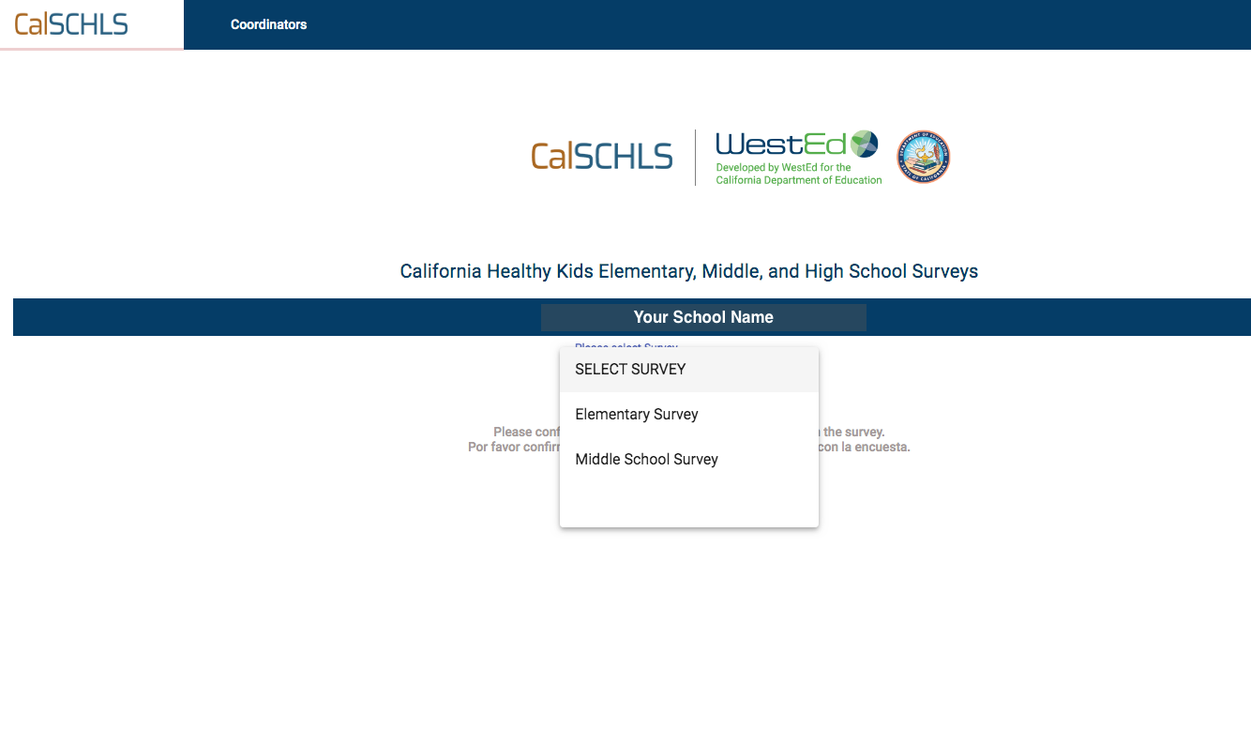
Grades K–8
5th grade
6th & 7th grade
Notes:
DELETE THIS SLIDE IF YOUR SCHOOL IS NOT A K-8 SCHOOL OR IF YOUR 6TH GRADERS WILL TAKE THE ELEMENTARY SURVEY (SEE NEXT SLIDE)

Slide 7
Grades K–8
5th & 6th grade
7th grade
Notes:
DELETE THIS SLIDE IF YOUR SCHOOL IS NOT A K-8 SCHOOL OR IF YOUR 6TH GRADERS WILL TAKE THE MIDDLE SCHOOL SURVEY (SEE PREVIOUS SLIDE)

Slide 8
Grades 6–8
6th grade
7th grade
Notes:
DELETE THIS SLIDE IF YOUR SCHOOL IS NOT GIVING 6TH GRADERS THE ELEMENTARY SURVEY

Slide 9
Grades 6–8
6th & 7th grade
Notes:
DELETE THIS SLIDE IF YOUR SCHOOL IS NOT GIVING 6TH GRADERS THE ELEMENTARY SURVEY

Slide 10
Grades 6–8
Notes:
DELETE THIS SLIDE IF YOUR SCHOOL IF YOUR SCHOOL IS NOT A MIDDLE SCHOOL

Slide 11
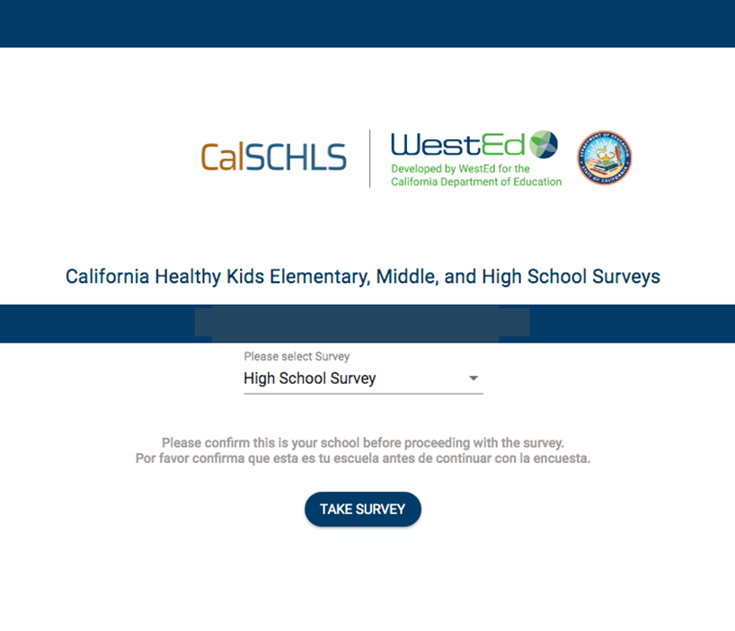
Grades 9–12
Notes:
DELETE THIS SLIDE IF YOUR SCHOOL IS NOT A 9-12 SCHOOL.

Slide 12
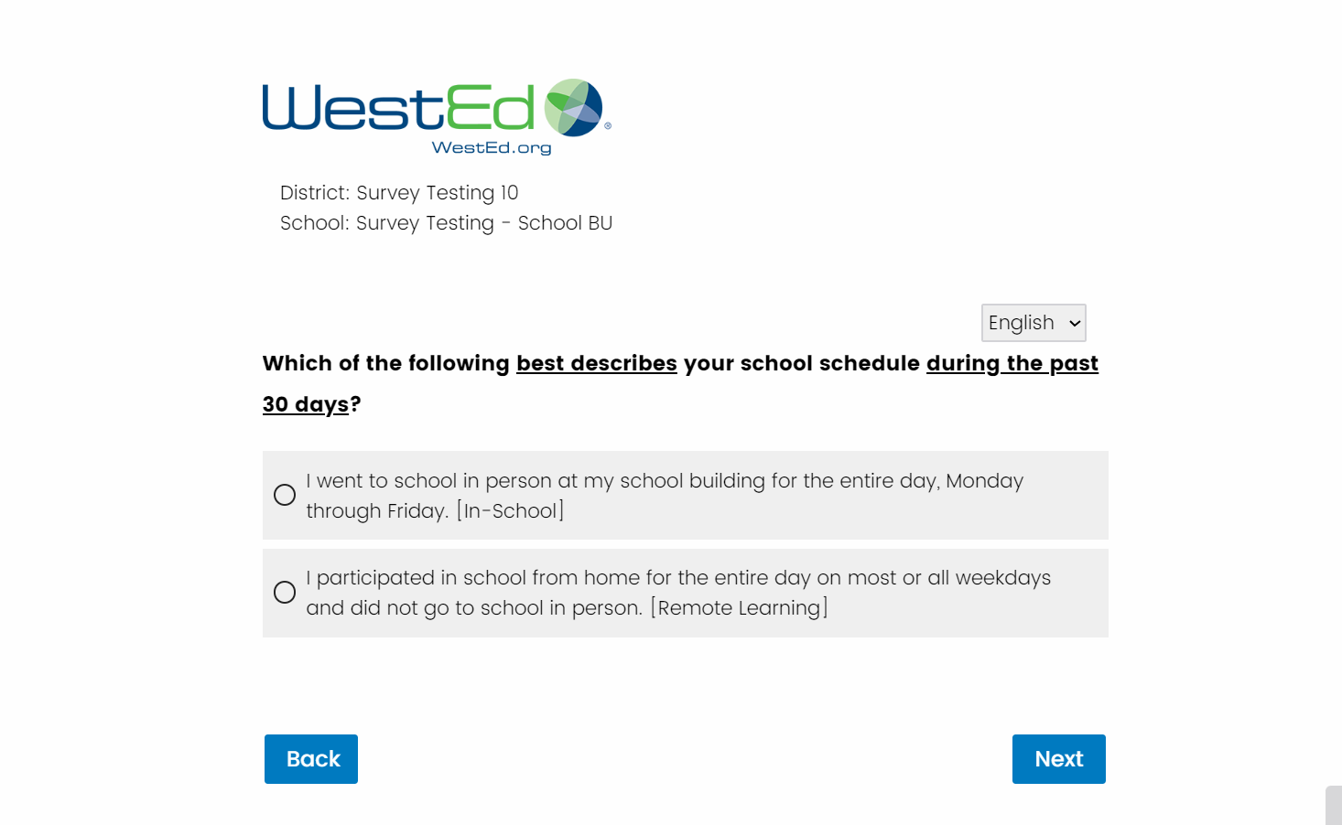
You may change the language of your survey.
One of the first questions asks about your school schedule during the past 30 days.
Select
IN PERSON
Notes:
DELETE THIS SLIDE IF YOUR SCHOOL IS REMOTE LEARNING ONLY

Slide 13
You may change the language of your survey.
One of the first questions asks about your school schedule during the past 30 days.
Select
REMOTE Learning
Notes:
DELETE THIS SLIDE IF YOUR SCHOOL IS IN PERSON LEARNING ONLY

Slide 14
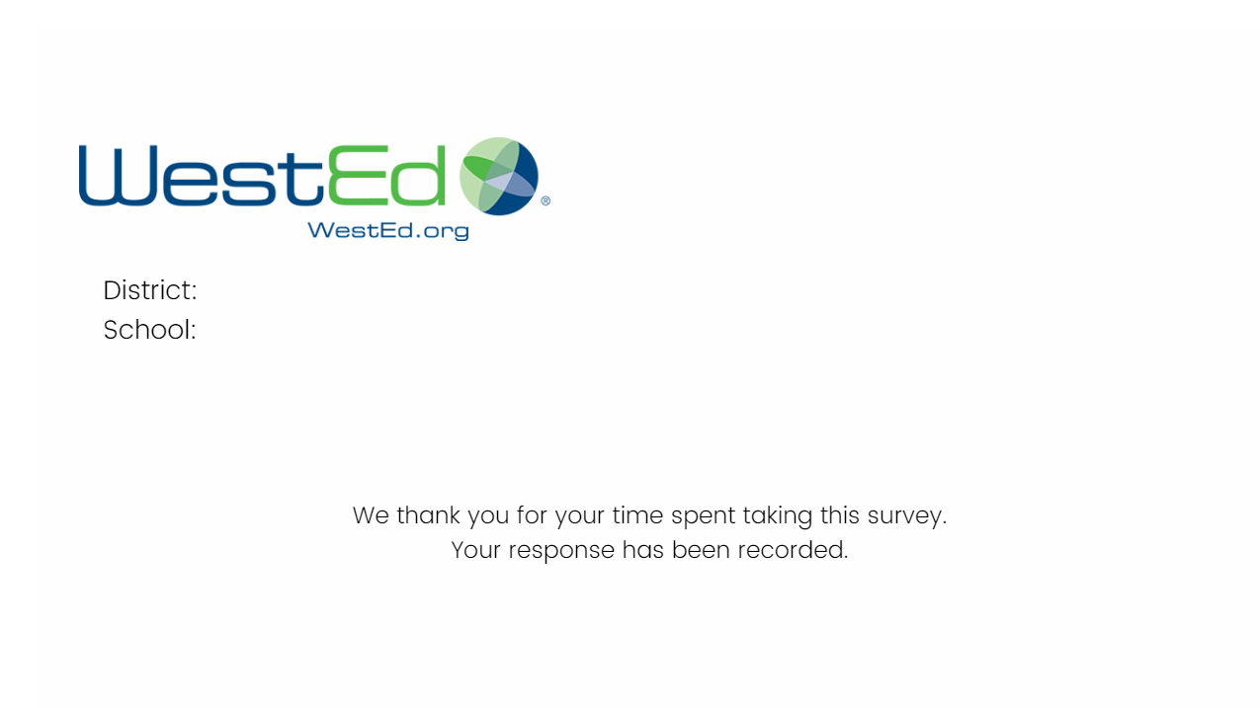
Your survey must be completed in one sitting. You may not log out and log back into this survey.
Final Instructions for Students
When you have completed your survey, please close your browser.

